Slide 1

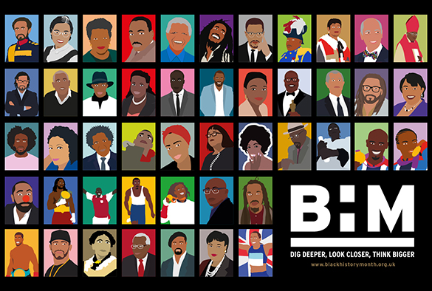

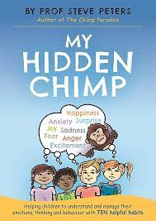
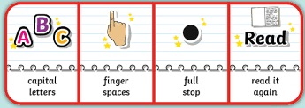
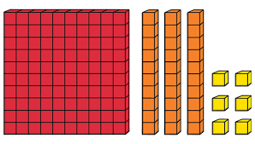

Owls Team
All About ME & Black History
Autumn 1
Owls Class
Maria Sava Class Teacher
Sunny McCall Teacher/Teaching Assistant
Gemma Dhol Teacher/Teaching Assistant
Joanne Martin Teaching Assistant
PSHE
In our ‘New Beginnings’ topic we will
be thinking about ourselves and our
roles in our new classes. We will also
be learning about our brains using
‘The Hidden Chimp’ and thinking about why we behave certain ways. We will think about which animal mimics our behaviour when we’re dysregulated and we will use drama to explore chimp scenarios – What would we do and what would we like to do?
Alongside our work on Black History month, we will be thinking about ‘Global Citizenship’ and what it means to be a part of a multi-cultural society. We will link this to work on anti-racism.
English
During our All About Me unit, we
will be developing our speaking
and listening skills in our new class. We will also be creating fact files and poems based on our likes and dislikes as well as creating simple autobiographies.
We will develop our sentence writing skills, focusing initially on basic punctuation. The main skills covered will be accurate use of capital letters and full stops, commas, noun phrases, verbs, adjectives, first person, and the past and present tenses.
Maths
We will begin this term
by consolidating and
developing our understanding of place value, focussing on partitioning and number lines with numbers up to 100 or 1000. We will then look at adding and subtracting numbers which includes carrying and exchanging over the 10s barrier.
Science
As part of our electricity topic, we will be investigating
mains and battery appliances, making simple circuits
and learning how to complete circuits. We will investigate a range of conductors and insulators and will carry out experiments to test these. We will make and use our own switches and take part in electrical discussions.

Slide 2

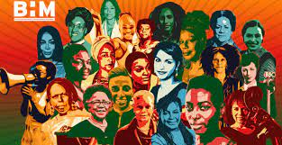
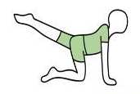
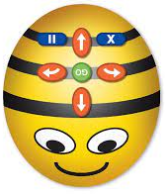
Owls Team
All About ME & Black History
Autumn 1
Owls Class
Maria Sava Class Teacher
Sunny McCall Teacher/Teaching Assistant
Gemma Dhol Teacher/Teaching Assistant
Joanne Martin Teaching Assistant
History
We will use our ICT skills to research and
learn about Key figures in Black History
and the present day along with learning
about racism and how we can tackle racism if we witness it. In art, we will design anti-racism posters and t- shirts and send entries to an anti–racism competition.
Art
We will be creating our own graffiti art using the computer and coloured markers. We will also be using watercolours to paint self-portraits and using papier-mâché to create picture frames.
PE
In P.E we will be learning the skills needed for gymnastics, including balancing rolling and sequencing movements into a routine.
How can you help at home?
Help me learn my times tables or basic number facts, e.g. number bonds to 10 and 20.
Encourage me to use my knife and fork correctly and be more independent with personal hygiene and self-care.
Encourage me to help you cook dinner, clear up and tidy away.
Read regularly together and ask me questions on the text.
Identify different types of punctuation used in the text you are reading. ? , ! ( )
Talk to me about what I am learning in school
Talk to me about my chimp and how my thinking brain can help me when I am struggling to manage.
Computing
We will be learning to code using Bee Bots. We will
explore using individual commands, identify what
each command for the floor robot does, and use that knowledge to start predicting the outcome of
programs. We will programme the Bee Bots to follow instructions and de-bug when there are mistakes in the code we have given them.

