Slide 1



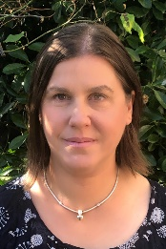
Falcons Team
All About Me & Black History
Autumn 1
Falcons Class
Andi Mitchell
Class Teacher
English
During our All About Me unit, we will be developing our speaking and listening skills in our new class. We will listen to our peers during group work, ask questions to find out more about them, and share our own likes & dislikes.
We will develop our handwriting skills; this will involve developing our fine motor skills so that we have more stamina for writing. We will practise identifying and forming both upper and lower case letters, as well as identifying the sounds that they make. Some of us will begin to write sentences independently using capital letters and full stops.
We will read a range of children’s books together and be able to give our own opinions about a story. We will retell a well known story in our own words and produce our own version.
PSHE
We will develop our understanding of our emotions; recognising that there is a normal range of emotions (happiness, sadness, fear, anger) that all people experience. We will begin to recognise and talk about our own emotions and explore how our behaviour is (or isn’t) proportional to how we are feeling. We will talk about our ‘hidden chimp brain’ and how we can help ourselves and each other manage the ‘big feelings’ we often experience.
Adam Waring
Teaching Assistant
Lisa Banks
Teaching Assistant
Maths
We will begin this term by consolidating and developing our understanding of place value, focussing on partitioning. We will explore number patterns such as ‘odd and even’ and counting in multiples of 2, 5, and 10. We will then look at adding and subtracting numbers which includes bridging ten. .
Science
Through our PSHE work we will begin to explore how eating a balanced diet and getting regular exercise can not only help our bodies get to stronger, but can also help our mental well-being.

Slide 2

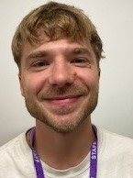
Falcons Team
All About Me & Black History
Autumn 1
Falcons Class
Andi Mitchell
Class Teacher
Art
Our sessions aim to encourage the children to have the confidence to use their imaginations when producing art work. We will provide materials for drawing, painting, and modelling, and will facilitate free expression. Art sessions will support work done in English and PSHE.
How can you help at home?
Help me practise counting in 1s, 2s, 5s, and 10s
Encourage me to look at the coins when we go shopping, house numbers, bus numbers etc
Encourage me to help you cook dinner, clear up and tidy away.
Read regularly together and ask me questions on the text.
Identify different types of punctuation used in the text you are reading. ? , ! ( )
Talk to me about what I am learning in school
Talk to me about my chimp and how my thinking brain can help me when I am struggling to manage.
Adam Waring
Teaching Assistant
Lisa Banks
Teaching Assistant
PE
In P.E we will be learning the skills needed to play ball games and we will develop our collaboration skills through learning a variety of team games. .

