Slide 1

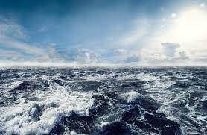
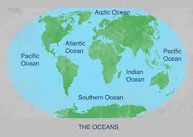
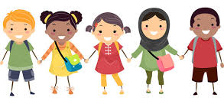
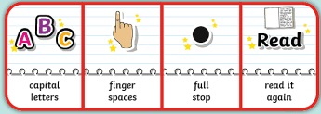
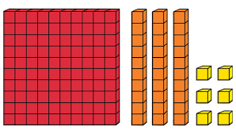
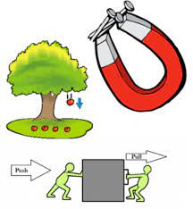
Oceans
Autumn 2
Owls Class
Owls Team
PSHE
We will think about
relationships in our ‘Getting
on and Falling Out’ unit. We will also think about bullying and how we can tackle bullying in our school community. We will make anti-bullying t-shirts and think about different scenarios that might happen and how we could react. We will also think about how to be safe online in school and at home.
In our learning, we will be thinking about what to do when we don’t feel motivated, what to do when we are upset/angry and we will create a just right program that fits our needs.
English
We will be reading and responding
to books about the ocean, such as
‘The Rainbow Fish’ and ‘Dipper in Danger’. We will write descriptive settings and an underwater adventure. We will also write simple non-chronological reports on sea creatures.
We will develop our sentence writing skills further this half term. The main skills covered will be accurate use of capital letters and full stops, commas, noun phrases, inverted commas, multi-clausal sentences, past tense, first person and past progressive tense (e.g. they were swimming).
Maria Sava Class Teacher
Sunny McCall Teacher/Teaching Assistant
Gemma Dhol Teacher/Teaching Assistant
Joanne Martin Teaching Assistant
Maths
We will continue to look at
addition and subtraction in
maths this half term, using our Place Value knowledge to happen. We will work on adding and subtracting numbers crossing the 10s and 100s barrier and begin to think about repeated addition and its links to multiplication.
Science
In our Magnets and Forces topic, we
will look at push and pull forces,
including gravity, water and air
resistance. We will design boats to test water resistance. Then we will investigate the strength of magnets, explore magnetic poles and observe how magnets attract different materials.

Slide 2
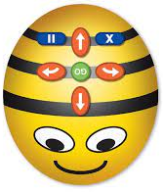

Oceans
Autumn 2
Owls Class
Owls Team
Geography
We will study the oceans and seas of the world.
We will map where they are and look at the
impact that the climate has on our oceans. We will look at the amount of plastics found within our oceans and what we can do to help reduce plastic waste.
Art
We will use a range of recyclable and non-recyclable materials to create sea creatures and seascapes in our Oceans topic.
Maria Sava Class Teacher
Sunny McCall Teacher/Teaching Assistant
Gemma Dhol Teacher/Teaching Assistant
Joanne Martin Teaching Assistant
Computing
We will continue to learn to code
using Bee Bots. We will
programme the Bee Bots to follow
instructions and de-bug when there are mistakes in the code we have given them. We will then use given commands in different orders to investigate how the order affects the outcome. We will also design algorithms, then test those algorithms as programs and debug them.
How can you help at home?
Help me learn my times tables or basic number facts, e.g. number bonds to 10 and 20.
Encourage me to use my knife and fork correctly and be more independent with personal hygiene and self-care.
Encourage me to help you cook dinner, clear up and tidy away.
Read regularly together and ask me questions on the text.
Identify different types of punctuation used in the text you are reading. ? , ! ( )
Talk to me about what I am learning in school
Talk to me about my chimp and how my thinking brain can help me when I am struggling to manage.
PE
In P.E., we will be having swimming lessons at The Prince Regent Swimming pool this half term.

