Slide 1
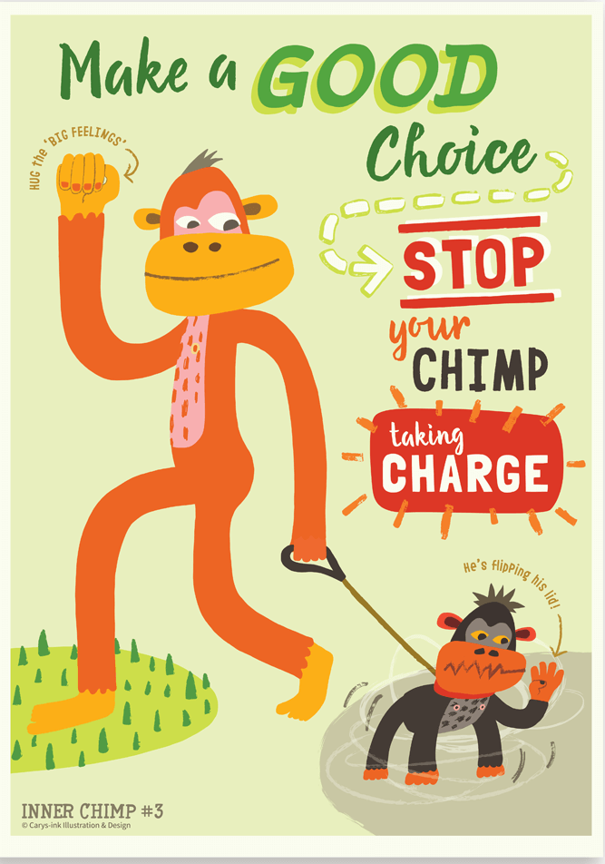
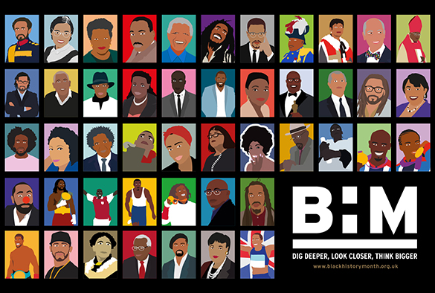

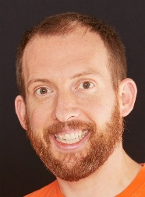
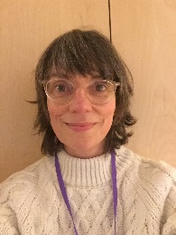
Eagles Team
All About ME & Black History
Autumn 1
Eagles Class
Richard Enticknap
Class Teacher
English
During our All About Me unit, we will be developing our speaking and listening skills in our new class. We will be interviewing each other to find out about our similarities and differences and we will also be creating poems based on our likes and dislikes. We will develop our sentence writing skills, focusing initially on basic punctuation and making sure our sentences make sense. The main skills covered will be accurate use of capital letters and full stops, commas, and adverbial phrases. We will continue to use VCOP (vocabulary, Connectives, Openings and Punctuation) to level up our work.
PSHE
In our ‘New Beginnings’ topic we will be thinking about ourselves and our roles in our new classes. Alongside this we will continue our work using ‘The Hidden Chimp’ and ‘Path through the Jungle’ books by Prof. Steve Peters – teaching the children all about their brains and how our genes and past experience shape them. We will think about how we behave when dysregulated and try to name an animal that mimics our actions. Through drama and our English work we will develop strategies to learn to deal with our big emotions.
Alongside our work on Black History month, we will be thinking about ‘Global Citizenship’ and what it means to be a part of a multi-cultural society. We will link this to work on anti-racism.
Lisa Stewart
Teaching Assistant
Laura Bobos
Teaching Assistant
Maths
We will begin this term by consolidating and developing our understanding of place value, focussing on partitioning and number lines with numbers up to 1000. We will then look at adding and subtracting numbers which includes carrying and exchanging over the 10s barrier.
Science
As part of our science week in the autumn term we will be learning about Forces. During the practical lessons the children will learn to identify forces as pushes and pulls. They will collect data and learn about air resistance, upthrust and gravity. Finally we will design and make an experiment to collect data on friction.
Joanne Martin
Teaching Assistant

Slide 2

Eagles Team
All About ME & Black History
Autumn 1
Eagles Class
Richard Enticknap
Class Teacher
History
We will use our ICT skills to research and learn about Key figures in Black History and the present day along with learning about racism and how we can tackle racism if we witness it. In art, we will design anti-racism posters and T- shirts.
Art
We will be creating our own graffiti art using the computer and coloured markers. We will also be using ICT and Mixed media to create some funky portraits
Lisa Stewart
Teaching Assistant
PE
Eagles class will be swimming this term. The sessions are taught by a qualified swimming instructor at The King Alfred Leisure Centre
How can you help at home?
Help me learn my times tables.
Encourage me to add up the cost of items when we go shopping or ask me how much change you should get.
Encourage me to help you cook dinner, clear up and tidy away.
Read regularly together and ask me questions on the text.
Identify different types of punctuation used in the text you are reading. ? , ! ( )
Talk to me about what I am learning in school
Talk to me about my chimp and how my thinking brain can help me when I am struggling to manage.
Laura Bobos
Teaching Assistant
Computing
We will start this term by learning about e-safety. The children will learn about the dangers of being online and how to keep safe. We’ll talk about SPAM, password security and appropriate apps. We will also look at the effect of social media on people’s wellbeing and how to spot fake news.
Joanne Martin
Teaching Assistant

