Slide 1


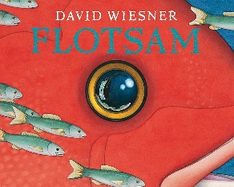
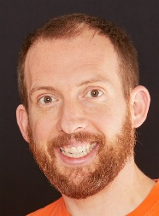
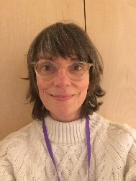
Eagles Team
Oceans
Autumn 2
Eagles Class
Richard Enticknap
Class Teacher
English
During our oceans topic we will be using the fantastic picture book Flotsam to inspire our creative minds. We’ll start by looking at a selection of flotsam and speculate on who it belonged too and where it came from. Children will use this as a way of practicing their sentence work a focus on questions. After that we will look at the book in more detail. We will write about what we see using powerful description and ask further questions about the unknowns. As antibullying week is in this term we will spend some time looking at the book ‘Just Kidding’ – a powerful book about the effects of bullying on children. The children will use this book as a basis to learn about speech writing and empathy.
PSHE
During our ‘Getting on and falling out’ topic this term we will be learning to appreciate our friendships and learn how to not demand too much from friends. We will also be learning to take responsibility for our choices and learn to resolve conflicts peacefully.
Anti-bullying week this year is in November and will have a theme which we will follow. During this week we will be working with the children across a range of subject to help stamp out bullying.
Lisa Stewart
Teaching Assistant
Laura Bobos
Teaching Assistant
Science
In this term’s science week we will be learning all about space! The children will start by explaining why we know the Sun, Earth and Moon are spherical and identify scientific evidence which does or does not provide evidence for an idea or argument. Children will learn the names of the planets and their order in the solar system. They will investigate night and day and learn about the phases of the moon.
Maths
For the second part of the term we will be practising the four operations: Addition, subtraction, multiplication and division. Children will work at their own level to move from using resources to formal methods for solving problems. Towards the end of term children will also learn about fractions.
Joanne Martin
Teaching Assistant

Slide 2
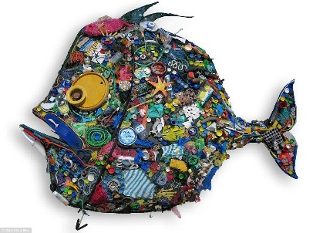

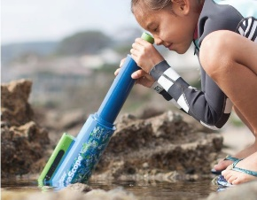
Eagles Team
Oceans
Autumn 2
Eagles Class
Richard Enticknap
Class Teacher
Geography
This term will have a geography focus starting with looking at the seas and oceans of the world. We will map where they are and look at the impact that the climate has on our oceans. We will look at the amount of plastics found within our oceans and what we can do to help reduce plastic waste.
Art
We will be creating art using recycled material and found objects on the beach. We will also try to create our own painting in the style of David Wiesner's Flotsam
Lisa Stewart
Teaching Assistant
PE
In P.E we will be learning the skills needed to play net games and we will develop our collaboration skills through learning a variety of team games. .
How can you help at home?
Help me learn my times tables.
Encourage me to add up the cost of items when we go shopping or ask me how much change you should get.
Encourage me to help you cook dinner, clear up and tidy away.
Read regularly together and ask me questions on the text.
Identify different types of punctuation used in the text you are reading. ? , ! ( )
Talk to me about what I am learning in school
Talk to me about my chimp and how my thinking brain can help me when I am struggling to manage.
Laura Bobos
Teaching Assistant
Computing
We will be using code in Scratch to follow weekly videos and concepts to tell fun, interactive stories. We will build new skills each week, ending in 'show what you know' one-off to demonstrate our learning. We will use Broadcasting, Loops and IF statements.
Joanne Martin
Teaching Assistant

