Slide 1



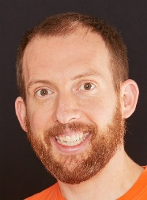
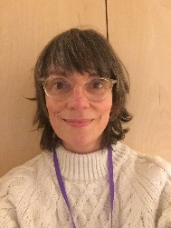
Eagles Team
Authors and Illustrators
Spring 1
Eagles Class
Richard Enticknap
Class Teacher
English
During our authors and illustrators topic the children will be reading all the wonderful Tom Percival books from his Big Bright Feelings collections. We will use the characters in our books to continue our work on the ‘inner chimp’ and look at Adverse Childhood Experiences. We will also be continuing our work on ‘The DOSE effect’ – helping children learn more about their brains. Through the wonderful stories children will write letters of advice to the characters and eventually write their own version of one of the stories.
Throughout the term we will be supporting children in their individual writing targets
PSHE
Along with the work we will be doing in English this term on the inner chimp and adverse childhood experiences, in PSHE we will be learning about our Mental Health and Wellbeing.
We will be exploring the concepts of Mental Health and Wellbeing and how to look after ourselves. We will be looing at the ups and downs of mental health and how sleep and bedtime routines can improve our moods and ability to achieve. Towards the end of the first spring term we will also be looking at challenging stereotypes.
Lisa Stewart
Teaching Assistant
Maths
For the first part of the spring term we will continuing our work on multiplication and division moving from informal methods such as the Grid method and chunking to more formal algorithms such as short and long multiplication and division. Next we will be learning about fractions, decimals and percentages and if children are ready, we may introduce some algebra.
Laura Bobos
Teaching Assistant
Science
In this term, we will be looking at materials and their properties. Children will compare materials according to their properties, investigate thermal conductors and insulators, investigate materials which will dissolve, use different processes to separate mixtures of materials and identify and explain irreversible chemical changes
Joanne Martin
Teaching Assistant

Slide 2

Eagles Team
Authors and Illustrators
Spring 1
Eagles Class
Richard Enticknap
Class Teacher
Art
Art is a big focus this term with the hope that children will be creating their own Tom Percival inspired stories and illustrating them ready for publishing. To get the children ready, we will be looking at Tom Percival art style and leaning from him using online tutorials. Children will use a variety of media to create final pieces including water colours and collage.
Lisa Stewart
Teaching Assistant
PE
In P.E this term we will be learning gymnastics. Children will learn the importance of good body position and how to apply weight evenly to roll and balance on the apparatus
How can you help at home?
Help me learn my times tables.
Encourage me to add up the cost of items when we go shopping or ask me how much change you should get.
Encourage me to help you cook dinner, clear up and tidy away.
Read regularly together and ask me questions on the text.
Identify different types of punctuation used in the text you are reading. ? , ! ( )
Talk to me about what I am learning in school
Talk to me about my chimp and how my thinking brain can help me when I am struggling to manage.
Laura Bobos
Teaching Assistant
Computing
This term we will be learning to use different Microsoft packages such as Word, Excel and Powerpoint
Geography/History
Joanne Martin
Teaching Assistant

