Slide 1

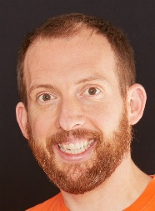
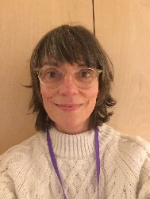
Eagles Team
World Studies
Spring 2
Eagles Class
Richard Enticknap
Class Teacher
English
Learning about other countries is always and exciting topic and each year we learn about a new one. During our English lessons, along with our continued grammar work, we will be researching all about our chosen country and learning how to write a persuasive leaflet to visit different locations around the country. The children will also use, and build on their skills from our ocean topic, to write non-chronological reports about something the are interested in. In our Dt/Food sessions we will be learning to make some foods from the chosen country and then the children will write instructions that the can take home and try with you.
PSHE
In PSHE this term the children will be learning about Legal and illegal drugs, peer pressure and getting help. They will also be learning about Alcohol education & the influence of the media. Brighton and Hove have written some excellent plans to support in the teaching of the difficult but important subject. Please feel free to speak to the class teacher if you have concerns or further questions.
Lisa Stewart
Teaching Assistant
Maths
For the second part of the spring term, we will be finishing off our work on fractions, decimals and percentages and moving on to area, perimeter and volume. Children will investigate shapes and their properties and use simple formula to solve problems. The last weeks of the term will be all about statistics.
Science
In the second part of the spring term we will be investigating electricity and light. The children will learn about circuits and how to draw them using the correct scientific diagrams. They will follow circuit diagrams to create their own circuits and then move on to investigating different components. Children will also be learning about light and shadows along with how the eye works.
Laura Bobos
Teaching Assistant
Joanne Martin
Teaching Assistant

Slide 2

Eagles Team
Japan
Spring 2
Eagles Class
Richard Enticknap
Class Teacher
Geography/History
Geography is a big part of this topic and we will be learning about the continents of the world and where Japan is on the map. We will look at and describe the climates and biomes of different regions across the country and identify similarities and differences in the human and physical geography of Brighton and a region of our chosen country
Art
In art, we will looking at the traditional art from the chosen country. Children will learn about famous artist and try to imitate their work
Lisa Stewart
Teaching Assistant
How can you help at home?
Help me learn my times tables.
Encourage me to add up the cost of items when we go shopping or ask me how much change you should get.
Encourage me to help you cook dinner, clear up and tidy away.
Read regularly together and ask me questions on the text.
Identify different types of punctuation used in the text you are reading. ? , ! ( )
Talk to me about what I am learning in school
Talk to me about my chimp and how my thinking brain can help me when I am struggling to manage.
PE
In P.E this term we will be swimming at the King Alfred Swimming pool.
Laura Bobos
Teaching Assistant
Computing
This term we will be using our computer skills to research and create a leaflet to advertise our chosen country. The children will be learning to use publisher for this task
Joanne Martin
Teaching Assistant

