Slide 1
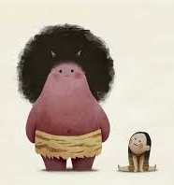
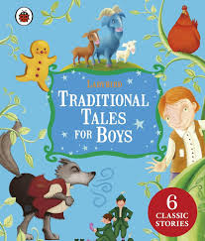

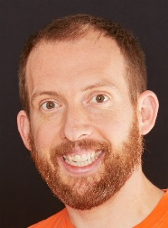
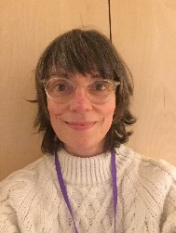
Eagles Team
Traditional tales
Summer 1
Eagles Class
Richard Enticknap
Class Teacher
English
After the Easter holiday, we will have a focus on traditional tales from around the world. During our English lessons, we will read a range of traditional tales from other countries such as Momotao the peach boy and Urashima Tarō from Japan and compare them to our English ones. The children will then use these stories as guides to writing their own versions using traditional characters. Eventually, the children will then turn these stories into playscripts that they will perform using puppets they have made in art.
PSHE
In PSHE this term the topic is Feeling Good Feeling Safe. In this topic the children will be learning about Protective Behaviours -
Using the Brighton and Hove schemes of work. Towards the end of the term children will then be working on relationships. Exploring loss and the coping strategies needed to support their mental health.
Lisa Stewart
Teaching Assistant
Maths
For the first part of the summer term, children will be learning about shape. In this topic, children will learn to identify and classify angles, draw lines accurately and calculate angles on a straight line and around a point. Children will learn to use protractors to measure angles accurately and find missing angles in polygons. Finally, towards the end of this term, children will learn about symmetry and translation on grids.
Science
This term we will be learning all about properties of change including solids, liquids and gases. During our science week we will have lots of practical experiments learning how the amount of energy can affect how things behave. We will learn to classify and group materials by their properties, including hardness, transparency and magnetism. We will also explore how some materials will dissolve in water and others will not.
Laura Bobos
Teaching Assistant
Joanne Martin
Teaching Assistant

Slide 2
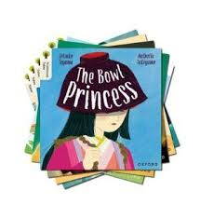


Eagles Team
Traditional Tales
Summer 1
Eagles Class
Richard Enticknap
Class Teacher
Religious education
In this term we will be looking at the traditions of the main religions. The children will learn about the history of each religion and how it is practised now. We will compare it to the other religions we have studied to find similarities and differences.
Art
In art this term we will be looking at art that links to traditional tales and creating puppets for the children to use with their playscripts.
Lisa Stewart
Teaching Assistant
How can you help at home?
Help me learn my times tables.
Encourage me to add up the cost of items when we go shopping or ask me how much change you should get.
Encourage me to help you cook dinner, clear up and tidy away.
Read regularly together and ask me questions on the text.
Identify different types of punctuation used in the text you are reading. ? , ! ( )
Talk to me about what I am learning in school
Talk to me about my chimp and how my thinking brain can help me when I am struggling to manage.
PE
In P.E this term we be learning how to play summer games such as cricket and rounders. Children will learn to throw and catch and how to play as part of a team
Laura Bobos
Teaching Assistant
Computing
This term we be using cameras and iPad to learn all about stop motion animation. Children will start with simple Lego figure movement and build up to telling a short story
Joanne Martin
Teaching Assistant

