Slide 1
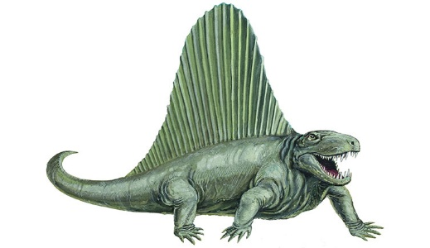
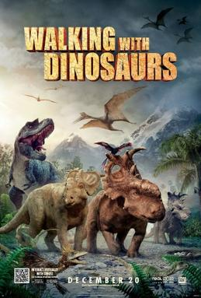

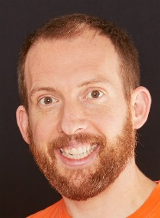
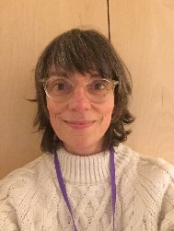
Eagles Team
Dinosaurs
Summer 2
Eagles Class
Richard Enticknap
Class Teacher
English
During the final term we are going to be learning all about dinosaurs. We will be researching and writing reports about our favourite dinosaurs using BBC programs such as walking with dinosaurs, the internet and hopefully even the Natural History museum in London.
PSHE
In this term children will be covering the Brighton and Hove Sex and relationship units based on their age. Also as this is the final term we will be focusing on celebrating success and moving on.
Lisa Stewart
Teaching Assistant
Maths
For the first part of the summer term, children will be learning about shape. In this topic, children will learn to identify and classify angles, draw lines accurately and calculate angles on a straight line and around a point. Children will learn to use protractors to measure angles accurately and find missing angles in polygons. Finally, towards the end of this term, children will learn about symmetry and translation on grids.
Science
This term science will be related to our PSHE topic and based around animals and humans. Children will learn about genetics and how humans and animals reproduce.
Laura Bobos
Teaching Assistant
Joanne Martin
Teaching Assistant

Slide 2

Eagles Team
Dinosaurs
Summer 1
Eagles Class
Richard Enticknap
Class Teacher
PE
In P.E this term we be learning how to play summer games such as cricket and rounders. Children will learn to throw and catch and how to play as part of a team
Art
In art this term we will be creating our own planets using papier-mâché to go with our Science topic. We will also be learning to cook healthy fake-away meals.
Lisa Stewart
Teaching Assistant
Forest/ Beach school
This term we will be getting the children out of the classroom and going to beach and forest school. During these sessions, children will learn to explore nature and learn skills such as lighting fires and using saws. There will also be a big focus on respecting nature.
How can you help at home?
Help me learn my times tables.
Encourage me to add up the cost of items when we go shopping or ask me how much change you should get.
Encourage me to help you cook dinner, clear up and tidy away.
Read regularly together and ask me questions on the text.
Identify different types of punctuation used in the text you are reading. ? , ! ( )
Talk to me about what I am learning in school
Talk to me about my chimp and how my thinking brain can help me when I am struggling to manage.
Laura Bobos
Teaching Assistant
Joanne Martin
Teaching Assistant

