Slide 1


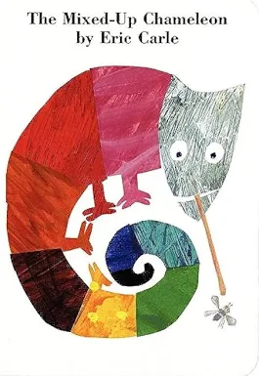
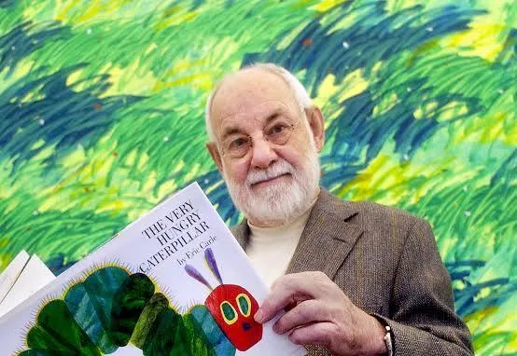

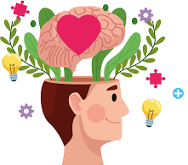
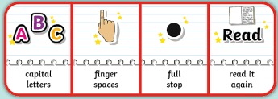
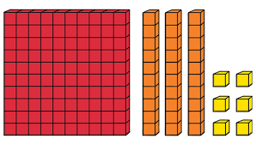
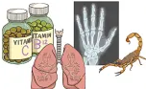
Authors and Illustrators
Spring 1
Owls Class
Owls Team
PSHE
In PSHE, we will think about
our mental health and
wellbeing. We will learn what
the terms mental health and wellbeing mean and discuss how we can support and improve our own mental health and wellbeing at home and at school.
After this, we will be thinking about equality in our school and wider community. We will think about what equality means and discuss how we can make sure everyone is treated fairly and with respect.
English
We will be reading and responding
to books by the author Eric Carle.
We will write book reviews and letters to the author and think about the characters in these stories. Then, we will write adventure stories and work hard to edit and publish these, adding our own illustrations.
We will continue to develop our sentence writing skills by including conjunctions and noun phrases in our writing. We will encourage children to use phonic knowledge and focus on the accurate use of capital letters, full stops and commas.
Maria Sava Class Teacher
Sunny McCall Teacher/Teaching Assistant
Gemma Dhol Teacher/Teaching Assistant
Joanne Martin Teaching Assistant
Maths
Our maths work will be based on our
individual knowledge and level of
understanding. We will all look at units of measure and use our Place Value knowledge to understand processes. Some of us will make the connection between repeated addition and multiplication by recognising equal groups and learn times table facts for the 2, 5 and 10 times tables.
Science
This half term we will be
learning about animals,
including humans. We will be
researching, investigating and learning about: animal skeletons; human skeletons; nutrition and food labels; muscles and organs.

Slide 2

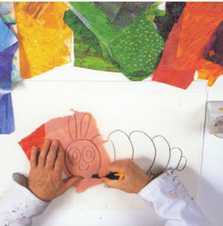


Authors and Illustrators
Spring 1
Owls Class
Owls Team
Geography
We will be learning all about The Chinese
New Year, the Chinese culture and
traditions. We will end with celebrating
Chinese New year with a Chinese banquet prepared by the children and eaten together as a whole school.
Art
In art, we will think about the
characters and scenes in our
English stories. We will use
Eric Carle’s illustrations to inspire us as we develop our own story illustrations.
Maria Sava Class Teacher
Sunny McCall Teacher/Teaching Assistant
Gemma Dhol Teacher/Teaching Assistant
Joanne Martin Teaching Assistant
Computing
In Computing, we will be learning all about online safety. We will learn about our digital footprints, the dangers of
chatting to people online and how to
keep ourselves safe
online. We will learn
what to do if people
are acting unsafe
online.
How can you help at home?
Help me learn my times tables or basic number facts, e.g. number bonds to 10, 20 and 100.
Encourage me to use my knife and fork correctly and be more independent with personal hygiene and self-care.
Encourage me to help you cook dinner, clear up and tidy away.
Read regularly together and ask me questions on the text.
Identify different types of punctuation used in the text you are reading. ? , ! ( )
Talk to me about what I am learning in school
Talk to me about my chimp and how my thinking brain can help me when I am struggling to manage.
PE
In P.E we will be learning the skills needed for invasion games such as football, basketball and netball. We will learn how to mark, pass, defend, attack and score. We will also be swimming this half term.

