Slide 1

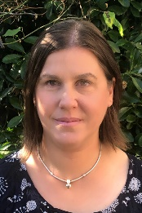
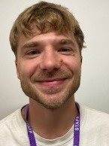
Falcons Team
Traditional Tales
Spring 1
Falcons Class
Andi Mitchell
Class Teacher
English
We will start our traditional tales topic by reading The Little Red Riding Hood. We will retell the story in our own words. We will learn that stories have a beginning, middle and end, we will work on sequencing the key events. We will read other traditional tales and compare them. We will perform a puppet show of our favourite traditional tale..
PSHE
We will continue to learn about our Hidden Chimps as we start to think about situations at home and school that we often find difficult. We will think of strategies to help us manage our emotions and behaviours in these situations.
Lisa Banks
Teaching Assistant
Alex Collins
Teaching Assistant
Maths
We will revisit addition and consolidate number bonds to ten, one more/one less, and adding ten. We will move on to days of the week, months and seasons. Seasons linked to English/Science.
Science
We will talk about the four seasons and link this to our English work on traditional tales.We will investigate what seeds need in order to grow.

Slide 2



Falcons Team
Traditional Tales
Spring 1
Falcons Class
Andi Mitchell
Class Teacher
Art
We will use a range of media to produce backdrops for our puppet show.
We will work on a collaborative project to build our set for our puppet show.
How can you help at home?
Help me practise counting in 2s, 5s, and 10s
Ask me ‘what is the next number?’
Help me learn the days and months.
Play counting games such as Snakes & Ladders with me.
Encourage me to help you cook dinner, clear up and tidy away.
Read regularly together and ask me questions on the text.
Identify different types of punctuation used in the text you are reading. ? , ! ( )
Talk to me about what I am learning in school
Talk to me about my chimp and how my thinking brain can help me when I am struggling to manage.
Lisa Banks Teaching Assistant
Alex Collins
Teaching Assistant

