Slide 1

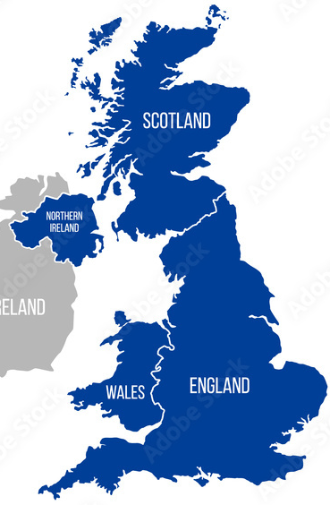

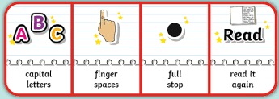
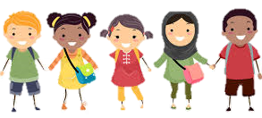
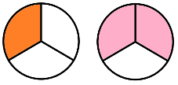
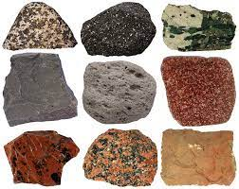

Countries: The UK
Spring 2
Owls Class
Owls Team
English
In English, we will write a fact
file about the different capital
cities in the UK. We will then think about the differences in living in the city and in the countryside and write a comparison text on this.
We will continue to develop our reading inference skills, build our vocabulary and develop our
sentence writing skills by including conjunctions and noun phrases in our writing. We will encourage children to use phonic knowledge and focus on the accurate use of capital letters, full stops and commas.
PSHE
In our ‘Good to be me’ topic,
we will be thinking about
how we are all similar and
what differences there are between us. We will celebrate our own identities, achievements and those of others. We will see how we fit into our community, celebrating diversity and challenging prejudice.
We will also be learning about drugs and alcohol and learning about the effects of these on people’s health and wellbeing.
Maria Sava Class Teacher
Sunny McCall Teacher/Teaching Assistant
Gemma Dhol Teacher/Teaching Assistant
Joanne Martin Teaching Assistant
Maths
Our maths work will be based on our
individual knowledge and level of
understanding. We will be learning about
fractions, mass and capacity this term. We will find fractions of shapes and order, compare and place fractions on a number line. We will use different scales to measure and will add and subtract different measurements and find equivalent measurements for mass and capacity.
Science
In Science this term we will be
learning all about Rocks. We will
compare different types of rocks
and group rocks based on our
observations. We will learn how fossils are formed and how soil is formed. We will learn about Mary Anning and how she contributed to the study of palaeontology.

Slide 2
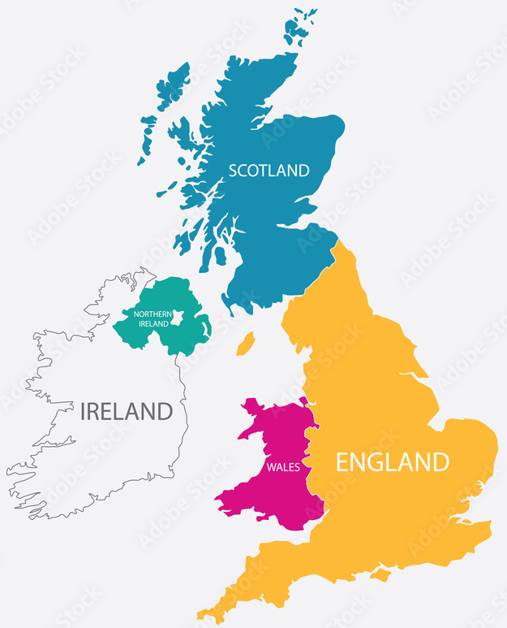

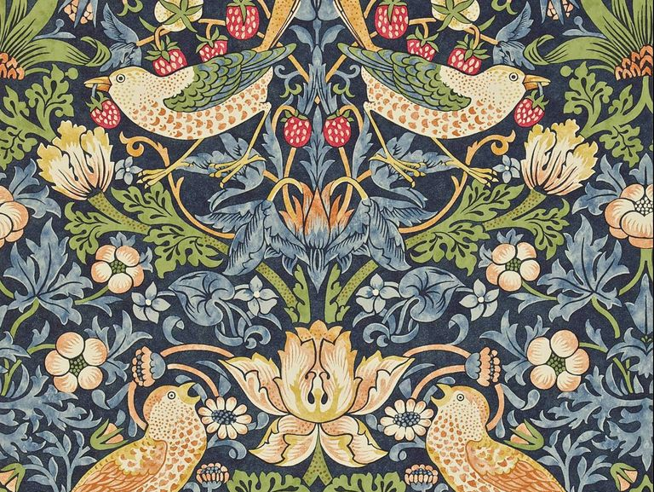

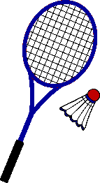
Countries: The UK
Spring 2
Owls Class
Owls Team
Geography
This half term, we will be looking at the continents of the world, specifically
focussing on the continent of Europe.
We will locate the UK on a map of
Europe and look at the country’s
regions, cultures, food, physical and
man-made features.
Art / DT
This term we will be making some
of the UK’s most common dishes. We
will also be looking at and recreating
some art by famous UK artists, such
as Banksy and William Morris.
Maria Sava Class Teacher
Sunny McCall Teacher/Teaching Assistant
Gemma Dhol Teacher/Teaching Assistant
Joanne Martin Teaching Assistant
How can you help at home?
Help me learn my times tables or basic number facts, e.g. number bonds to 10, 20 and 100.
Encourage me to use my knife and fork correctly and be more independent with personal hygiene and self-care.
Encourage me to help you cook dinner, clear up and tidy away.
Read regularly together and ask me questions on the text.
Identify different types of punctuation used in the text you are reading. ? , ! ( )
Talk to me about what I am learning in school
Talk to me about my chimp and how my thinking brain can help me when I am struggling to manage.
Computing
The children will develop an
understanding of digital devices and compare digital and non-digital devices. We will be identifying inputs, processes, and outputs for digital devices. Identify devices that make up a network, such as PCs, tablets, laptops as well as the network switch, server and wireless access points.
PE
We will be developing our skills in net games. The children will experience playing badminton and table tennis and will learn how to serve, use over arm and under arm techniques, and rally with their opponent.

