Slide 1

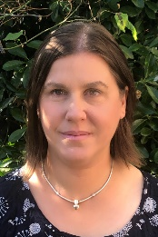
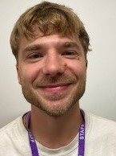
Falcons Team
Spring 2
Falcons Class
Andi Mitchell
Class Teacher
English
We will read and respond to the books ‘Vlad and the Great Fire of London’ and ‘Toby and the Great Fire of London’ and use these when doing descriptive writing. We will use adjectives in our own sentences
We will continue our phonics and word-level work which is tailored to ‘fill the gaps’ for each individual child.
PSHE
We will continue our work on ‘The Hidden Chimp’ and how this can lead to falling out with friends. We will look at what makes a good friend and how we can be a good friend to others.
Lisa Banks
Teaching Assistant
Alex Collins
Teaching Assistant
Maths
We will consolidate our number bonds to 10/20/100. We will then move on to Fractions. We will investigate halving and doubling, finding equal amounts, and recognising a quarter.
We will make clocks and learn how to tell the time to the hour and half hour.
Science
This term we will be looking at Light & Dark. We will start by identifying a range of light sources. We will investigate shadows and will link this to our art and maths work (silhouettes/measuring).

Slide 2

Falcons Team
Spring 2
Falcons Class
Andi Mitchell
Class Teacher
Art
In art we will produce silhouettes using a combination of chalks and cut paper. In DT we will learn about axles, chassis and wheels as we make fire engines.
How can you help at home?
Help me practise counting in 2s, 5s, and 10s
Ask me ‘what is the next number?’
Help me learn the days and months.
Play counting games such as Snakes & Ladders with me.
Encourage me to help you cook dinner, clear up and tidy away.
Read regularly together and ask me questions on the text.
Identify different types of punctuation used in the text you are reading. ? , ! ( )
Talk to me about what I am learning in school
Talk to me about my chimp and how my thinking brain can help me when I am struggling to manage.
Lisa Banks Teaching Assistant
Alex Collins
Teaching Assistant

