Slide 1
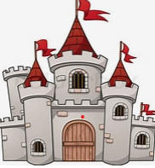

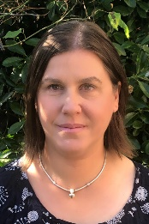

Falcons Team
Summer 1
Falcons Class
Castles
Andi Mitchell
Class Teacher
English
We will continue with daily phonics sessions through ECaR combined with other word level work. We will look at non-fiction texts linked to our Castles topic; we will be able to identify features such as headings, diagrams, captions, and paragraphs. We will produce our own ‘fact file’ about a castle we have visited. We will use drama activities to explore what everyday life was like inside a castle.
We will continue to practise handwriting everyday, including joining up letters.
We will continue to share a range of fiction books during class story time. Children will be encouraged to give their opinions about the stories, make predictions, and compare
PSHE
We will continue to learn about the range of emotions that we experience and practise naming our emotions. We will explore the physical changes in our bodies linked to certain emotions e.g. faster heartrate, going red in the face, and see if we can use these as clues to regulate more quickly. We will also consider if we can use these clues to help our friends and family members when they are dysregulated.
Lisa Banks
Teaching Assistant
Alex Collins
Teaching Assistant
Maths
At the start of the term we will revisit and consolidate our work on place value. We will begin to think about larger numbers and be able to give one more and one less.
We will use language around Position and Direction, and link this to our Castles topic.
Geography & History
We will research when and why people started building castles. We will learn about the key features of different castles and how they were defended. We will learn about everyday life inside a castle.
We will visit a local castle (Lewes) and keep a photographic record of our visit including artefacts and costumes that we see. We will use this when building our own castles in DT.

Slide 2

Falcons Team
Summer 1
Falcons Class
Andi Mitchell
Class Teacher
Art/DT
Linking in to our Castles topic we will create our own Coats of Arms.
We will use junk modelling to build our own castles.
How can you help at home?
Help me practise counting in 2s, 5s, and 10s
Ask me ‘what is the next number?’
Help me learn the days and months.
Play counting games such as Snakes & Ladders with me.
Encourage me to help you cook dinner, clear up and tidy away.
Read regularly together and ask me questions on the text.
Identify different types of punctuation used in the text you are reading. ? , ! ( )
Talk to me about what I am learning in school
Talk to me about my chimp and how my thinking brain can help me when I am struggling to manage.
Lisa Banks Teaching Assistant
Alex Collins
Teaching Assistant

