Slide 1

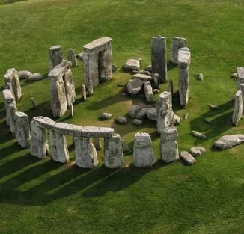
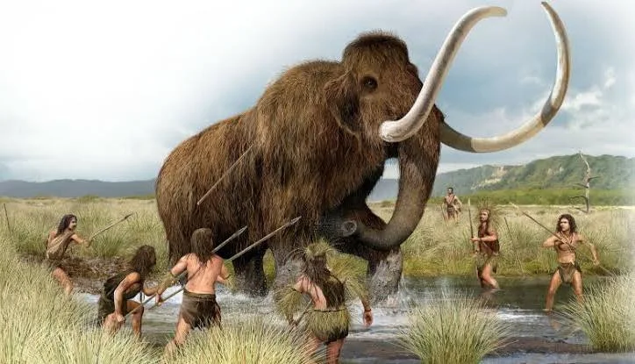
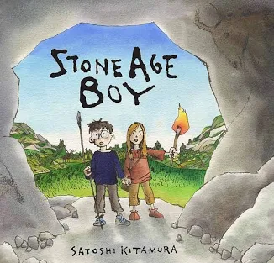
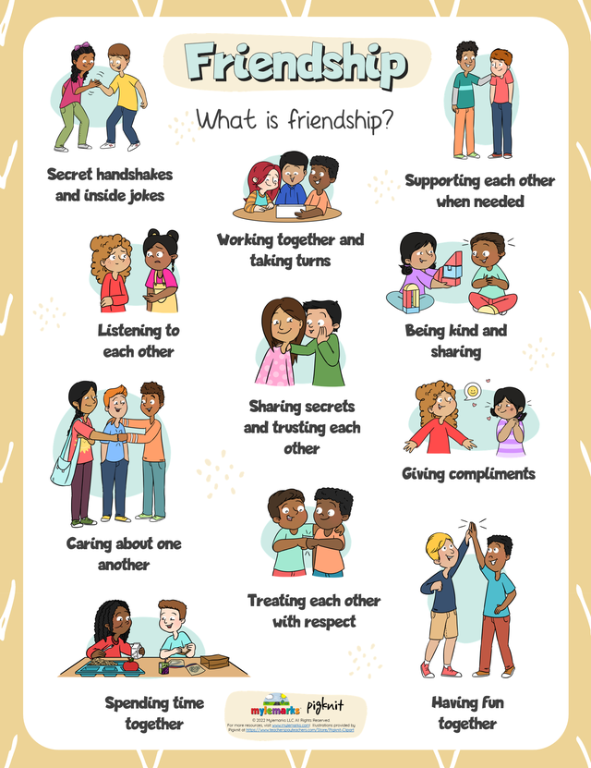
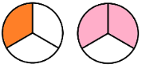

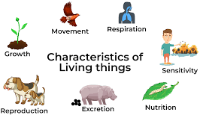
Stone Age
Summer 2
Owls Class
Owls Team
English
We will be reading ‘Stone Age
Boy’ by Satoshi Kitamura and
‘Stone Age, Bone Age!’ by Mick
manning and Brita Granstrom.
We will write a recount, based on
living in the stone age. We will write instructions on how to wash a Wooly Mammoth, along with researching and writing a non-chronological report. We will continue to develop our sentence writing skills further this half term, focussing on speech punctuation, conjunctions, commas, adjectives and noun phrases.
PSHE
This half term we will explore the physical
changes of our body through puberty and
emotional changes as we grow up. We will
also be thinking about our relationships with
others and how these change and develop over time.
We will also think about moving on to next stages and what our education will look like next year.
Maria Sava Class Teacher
Sunny McCall Teacher/Teaching Assistant
Gemma Dhol Teacher/Teaching Assistant
Joanne Martin Teaching Assistant
Science
In Science this term we will be studying living things and their habitats. We will group living
things and use classification keys to identify vertebrates. We will
investigate our local
environment and we
Will find out about
environmental changes
and the dangers to wildlife.
Maths
Our maths work will be based on our
individual knowledge and level of
understanding. The big focus this term
will be telling the time, knowing the days of the week and months of the year. We will be continuing fraction work, looking at finding fractions of objects, amounts and money. We will also learn how to add and subtract fractions.

Slide 2
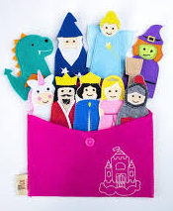
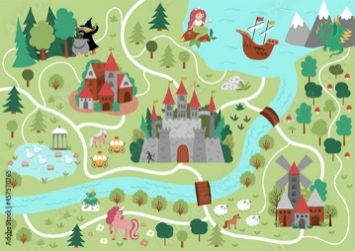
Stone Age
Summer 2
Owls Class
Owls Team
Art / DT
We will make finger puppets to help
tell traditional tales. Touched theatre
group come in to work with the
children to create puppets, which
they then use to create a short film.
Geography
We will be developing our mapping skills and investigating our local area in
geography. We will discuss what a
map is and why we need them. We
will make a simple map of the
settings in a traditional tale.
Maria Sava Class Teacher
Sunny McCall Teacher/Teaching Assistant
Gemma Dhol Teacher/Teaching Assistant
Joanne Martin Teaching Assistant
Computing
We will be learning about data and information in computing using branching databases. We will use yes/no questions to gain an understanding of what attributes are and how to use them to sort groups of objects. We will create physical and on-screen branching databases and create an identification tool using a branching database.
How can you help at home?
Help me learn my times tables or basic number facts, e.g. number bonds to 10, 20 and 100.
Encourage me to use my knife and fork correctly and be more independent with personal hygiene and self-care.
Encourage me to help you cook dinner, clear up and tidy away.
Read regularly together and ask me questions on the text.
Identify different types of punctuation used in the text you are reading. ? , ! ( )
Talk to me about what I am learning in school
Talk to me about my chimp and how my thinking brain can help me when I am struggling to manage.
PE
This half term we will be playing striking and fielding games. We will focus on Cricket, Rounders and Stoolball. We will develop fielding skills and practice our throwing and bowling skills with targets. We will also develop striking skills learning how to hit into space.

