Slide 1

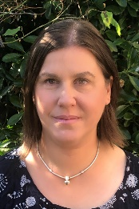
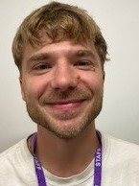
Falcons Team
Summer 2
Falcons Class
Moving On
Andi Mitchell
Class Teacher
English
We will continue with daily phonics sessions through ECaRcombined with other word level work. We will talk about our favourite books and be able to tell our friends why we like them. We will write a book review to pass on to a new child coming into the class.
We will look back over our reading and writing work this year and note all the things we have learned and where we have improved. We will think about our targets as we move on from Falcons class.
We will write letters to our new teachers telling them all about ourselves.
PSHE
We will be following the statutory Relationship and Sex Education objectives for our specific year group.
We will be talking about our thoughts, feelings and worries about the transition to our next class. We will come up with different ways of managing the big feelings associated with such a transition.
Lisa Banks
Teaching Assistant
Alex Collins
Teaching Assistant
Maths
We will start the term revisiting addition and subtraction. We will learn how to collect simple data using tally charts and how to present this in a bar chart. We will learn how to read bar charts.
.
Science
We will be learning about life cycles; focusing initially on humans (at year group specific levels) and also looking at other creatures such as frogs.

Slide 2

Falcons Team
Summer 2
Falcons Class
Moving On
Andi Mitchell
Class Teacher
Art/DT
We will be creating art based on our local area. We will look for inspiration in the work of Andy Goldsworthy and then use things we have found in nature to produce our own work.
How can you help at home?
Help me practise counting in 2s, 5s, and 10s
Ask me ‘what is the next number?’
Help me learn the days and months.
Play counting games such as Snakes & Ladders with me.
Encourage me to help you cook dinner, clear up and tidy away.
Read regularly together and ask me questions on the text.
Identify different types of punctuation used in the text you are reading. ? , ! ( )
Talk to me about what I am learning in school
Talk to me about my chimp and how my thinking brain can help me when I am struggling to manage.
Lisa Banks Teaching Assistant
Alex Collins
Teaching Assistant

